Slide 1


SATs Parents’ Meeting
January 2026

Slide 2
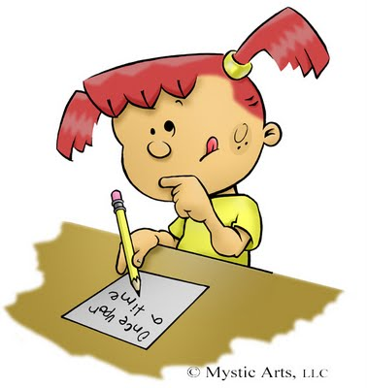
What are SATs?
SATs are national Statutory Assessment Tests of learning in KS2 (end of Juniors)
There are three subjects tested in SATs week through booklets: Maths, Reading and Grammar, Punctuation & Spelling (GPS)
Writing is Teacher Assessed by looking at the children’s writing throughout the year, but focusses mostly on the work produced in March to June (as this is their best writing!)
Science is Teacher Assessed

Slide 3

The tests cover objectives from Y3-6.
Tests provide a snapshot of a child’s performance in that test, on that day. Secondary transition can also include teacher’s professional judgements.
Why do we do SATs?
Government requirement.
Inform secondary school of the child’s attainment.
So the children themselves can see and understand how they are getting along with their learning. Good preparation for future exams.
Used to support target setting for future exams.
A skill that they will need to use at KS3 and 4.

Slide 4
When are SATs?
SATs week is MONDAY 11th – THURSDAY 14th May 2026 (T5,wk4). Tests normally take place in the KS2 hall.
Monday 11th May | Tuesday 12th May | Wednesday 13th May | Thursday 14th May
English grammar, punctuation and spelling test: Paper 1 - Short answers (50 marks – 45 mins) English grammar, punctuation and spelling test: Paper 2 - Spelling (20 marks -15 mins) | English Reading test Reading texts and an associated answer booklet (50 marks - 1 hour reading and working time) | Mathematics: Paper 1 – Arithmetic (40 marks - 30 mins) Mathematics: Paper 2 – Reasoning (35 marks - 40 mins) | Mathematics: Paper 3 – Reasoning (35 marks - 40 mins)
Only in very exceptional circumstances can this be altered so please ensure children attend school on these days. Ring the school as soon as possible if you have any concerns.

Slide 5
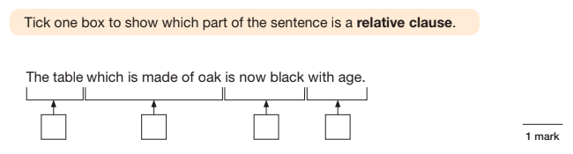
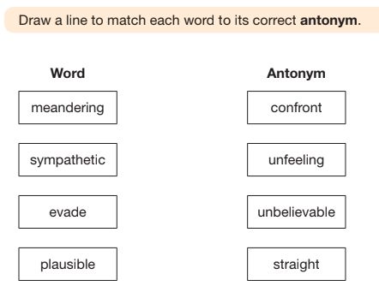
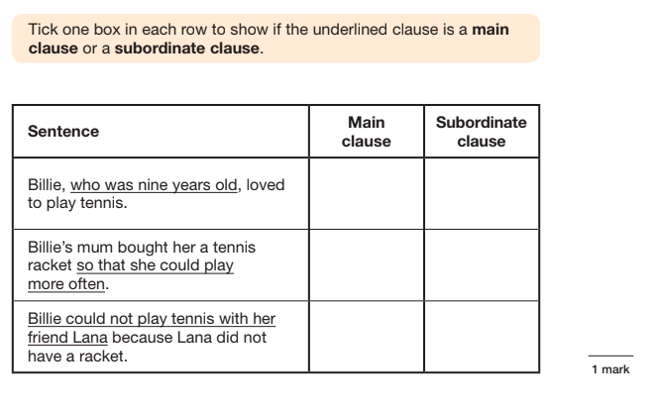
Monday – GPS – Paper 1
45 minutes (50 marks). Score combined with Paper 2.
  Covers Grammar terminology (nouns, verbs etc), sentence structure (phrases and clauses), punctuation and spelling (prefixes, homophones etc.)

Slide 6
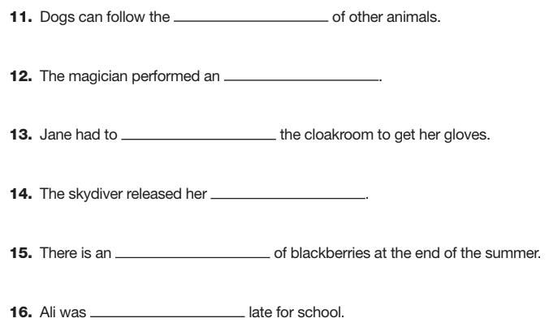
Monday – GPS – Paper 2
20 spellings testing the rules and patterns from all of KS2.
20 marks.

Slide 7
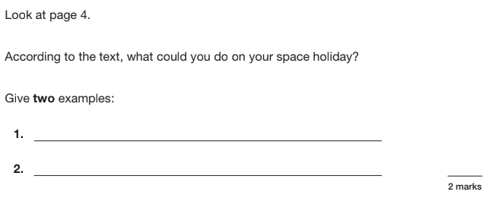
Tuesday – Reading Paper
Reading booklet contains three texts of increasing difficulty.
Children have 1 hour to answer the questions and can refer to the booklet throughout. 50 marks in total.
Questions can be short answers, longer sentences or ticking, numbering or matching in style.

Slide 8
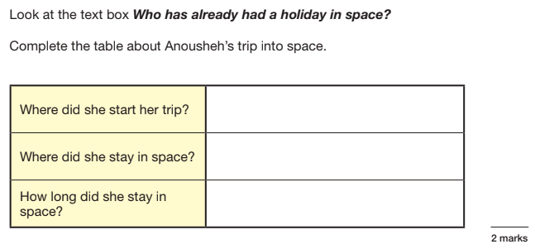
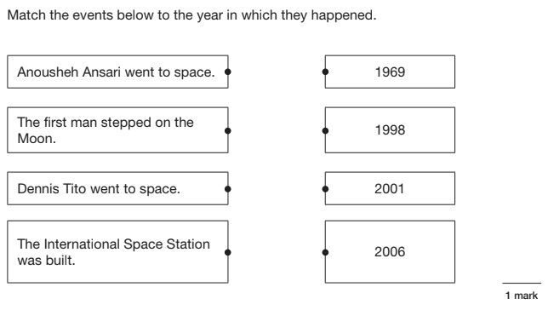
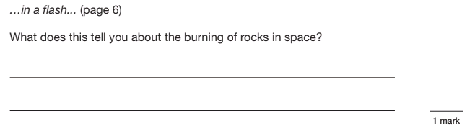

Slide 9
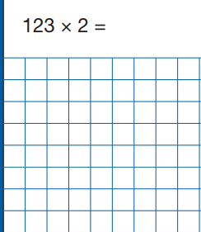
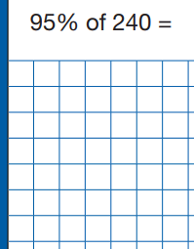
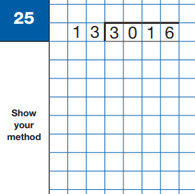
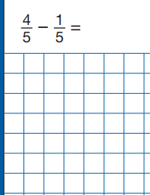
Wednesday – Maths Paper 1 - Arithmetic
30 minutes (40 marks)
Calculations involving all 4 operations, including fractions, decimals and percentages, long division and long multiplication.

Slide 10
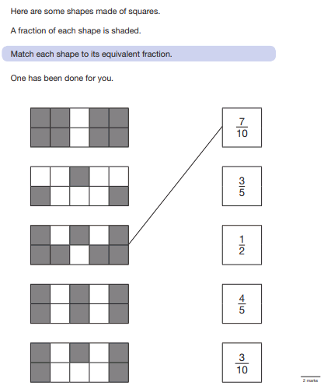
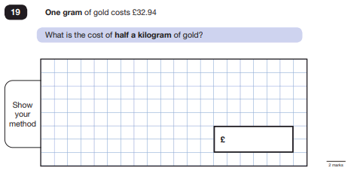
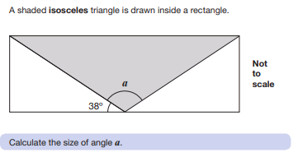
Wednesday – Maths Paper 2 - Reasoning
40 minutes (35 marks)
Mathematical fluency, solving problems and reasoning.

Slide 11
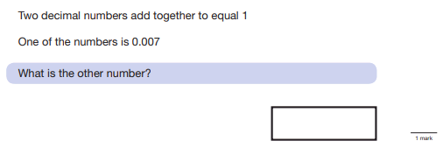
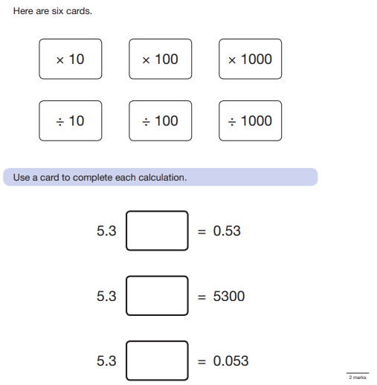
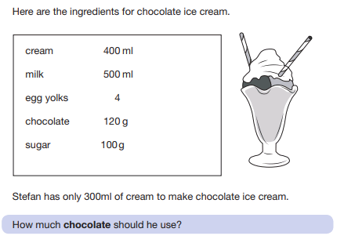
Thursday – Maths Paper 3 - Reasoning
40 minutes (35 marks)
Mathematical fluency, solving problems and reasoning.

Slide 12
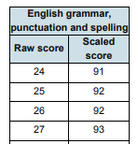
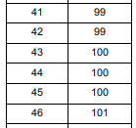
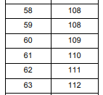
How are the results reported?
The scores are totalled for the papers (eg GPS + Spelling).
This creates a ‘Raw Score’.
The STA (Standards and Testing Agency) decides on the mark that is the expected standard and this is given a Scaled Score of 100.
Scaled Scores range from 80 to 120.
A scaled score of 100 or more shows the child has ‘Achieved the Standard’ (AS).
A scaled score below 100 shows the child has ‘Not Achieved the Standard’ (NS).
A scaled score of 110 or more shows the child is working at ‘Greater Depth’.
You will find out their results when your child’s school report comes out in July.

Slide 13
How are the results reported?
Children’s writing is assessed by the class teacher according to the ‘Interim Framework’.
This is a list of statements that children have to show they can achieve in a range of their work. They cover writing for a range of purposes, varying sentence structure, punctuation, using levels of formality, organisational features, ambitious vocabulary, spelling, handwriting etc.
This is reported in the following way:
If children show all the statements, they are ‘Working at Expected Standards’. (EXS)
If the children show some but not all the statements, they are ‘Working Towards the Standards’. (WTS)
If the children show further statements, they are working at ‘Greater Depth’. (GD)
Children’s writing can be deemed to be pre-key stage 2.

Slide 14
Access arrangements
Adjustments to how the SATs are delivered can be made for pupils who have additional or specific needs.
This is based on normal classroom practise.
It can include rest breaks, extra time, having a reader or working in a separate room.
We have to justify and provide evidence for why we have made these arrangements and this may be checked by LA monitoring visits.
We will submit this request by 21st May.
We will inform you if we feel this would be applicable to your child – but do let us know if you have any concerns.
We can also request that circumstances be taken into account that may impact on your child in the run up to or during SATs week (eg illness in the family). Please let us know if there is anything you think we need to consider.

Slide 15

Revision
Within the next week, the children will be issued with revision materials and additional homework to help prepare them for the SATs.
We strive to get children prepared and confident for the tests, but not at the expense of other subjects and their personal well-being.
There will be more homework, often due the next or following days, but these will be brief tasks that should not take more than 15 minutes.
We also provide revision materials and guides that children (and parents) can access as and when they choose/ need.

Slide 16

Monitoring so far and
preparation
Progress so far
I have been monitoring the children’s progress since the beginning of Year 6. We have completed two rounds of assessment and will have two more before SATs week. I will update you at parents' evening, or possibly before if I feel necessary. Please pop in and see me if you would like an update.
Preparation
As the term progresses, a range of interventions will run to support the children’s learning and understanding. These could be to help the children meet the expected standard or to help them achieve Greater Depth. They will work individually or in small groups with an adult on a specific skill and then return to class. They normally last for around 20 minutes.

Slide 17
Well-being
Leading up to SATs:
- Whilst we will be working hard leading up to SATs, it will not dominate our curriculum. We will still do Topic lessons in the afternoon, get outside as much as possible and keep ourselves active in PE etc. There are many aspects of the Year 6 curriculum, especially during those summer months, that I still want the children to experience.
- We will have a Mock Week two weeks before the real thing, just to practise being in the hall and completing the tests under formal conditions.
- We will also do lots of work around our well-being and having a positive attitude going into SATs week. They will be very rehearsed and ready!
I want everybody to achieve their potential.

Slide 18



How can you help?
NOW:
Ensure maximum attendance – no missed learning!
Support with revision guides pack and CGP practice books
Support with homework /SATs practice folders
Apply for homework clubs/attend revision sessions
Inform us of any concerns (sooner rather than later!)
DURING SATs WEEK:
Please ensure children:
Are in school (tests are statutory and at specified times )
Keep calm
Have plenty of sleep
Have a good breakfast (SATs Breakfast Club!)

Slide 19
Thank you for listening.
Any questions?

