Slide 1
Parent/ Carer Introduction to Phonics and Early Reading

Slide 2
Welcome!
What is phonics?
The alphabetic code
Blending
Reading and books
Reading at home
Spelling
Concerns about progress
Questions and next steps
Notes:
Welcome parents to the session.
We are very excited they are here to learn about the most amazing journey that their children are starting – learning to read!!!

Slide 3
We love reading!
Reading for pleasure
Finding out information
Reading the world around them
Accessing learning
Following instructions
Notes:
Reading is one of the most important things we can teach our children. We want all our children to be avid readers with a love for all different types of literature.
In Manorbrook, reading is one of our top priorities and we see ‘learning to read’ as the key first step in a life of ‘reading to learn’.

Slide 4

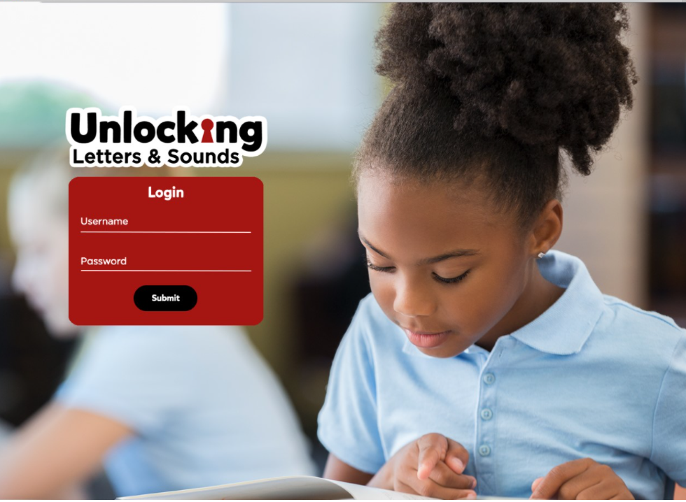
What is Phonics?
Link between the words we say and the letters that represent each sound.
MAP M-A-P
Grapheme – the written letter or groups of letters
Phoneme – the sounds that the grapheme makes.
Notes:
Over the past 50 years schools have taught children to read using lots of different approaches. But, thanks to research we know that phonics is the best way to teach children to read. At Manorbrook we use a scheme called Unlocking Letters and Sounds.
Phonics teaches the link between the words we read/ say and the words we write on the page. It teaches how the letters in written words represent the sounds we say in spoken words – this is called decoding.
Sat the word CAT. When we say this word we say lots of sounds very quickly – so quickly we hardly notice the sound each letter makes.
Say the sounds in CAT c/a/t What sounds can we hear? When we write the word cat we represent each sound with a symbol that we call a letter.
This is phonics!
There is some technical vocabulary that we use for phonics and that your children will use.
Grapheme – the written letter or groups of letters
Phoneme – the sounds that the grapheme makes.

Slide 5
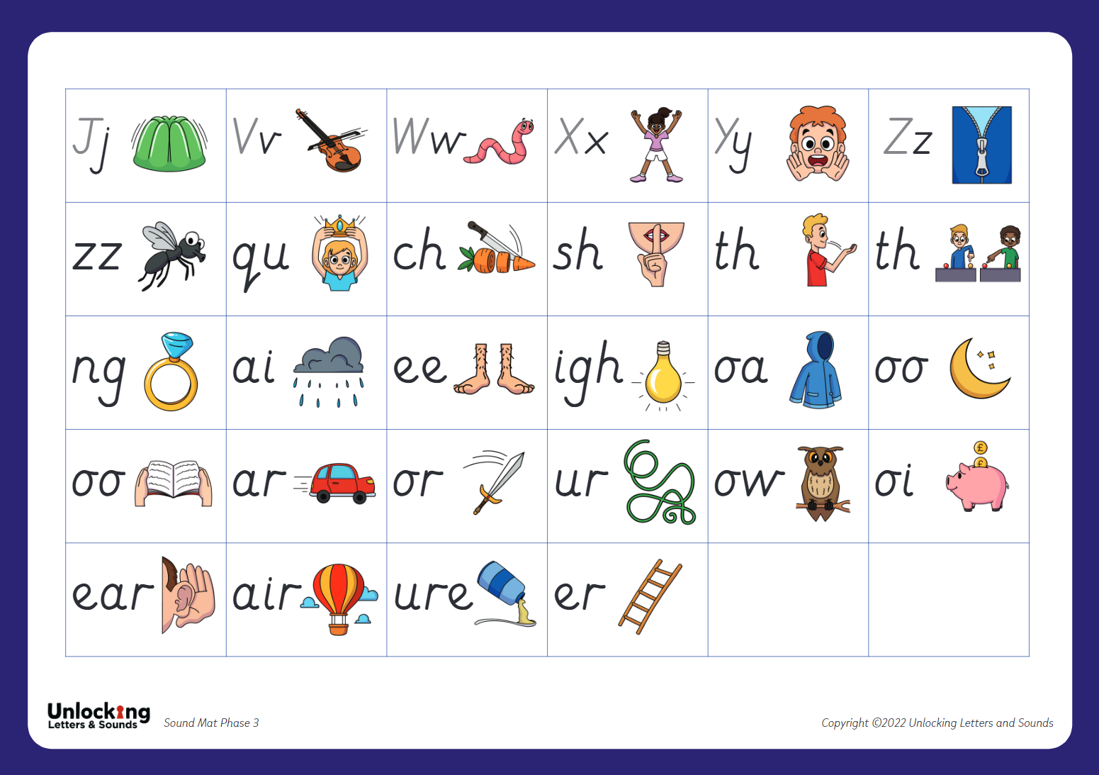
How phonics is taught
Pure sounds
Learn each GPC with an image and action
Correct formation of each letter is also taught
Notes:
As children start to learn their grapheme phoneme correspondences (GPCs) it is very important that we pronounce the sounds clearly and purely. We also help them to learn and remember the GPCs in Reception with an image and action for each phoneme. Your children will be coming home sharing the actions with you so do join them when they are using them!
Model pronunciation and actions for some of the first GPCs children will be learning.

Slide 6
The Alphabetic Code
44 phonemes
in different combinations
Simple Code
Basic phonemes and their matching graphemes, including digraphs and trigraphs
Complex Code
Sounds that are represented by different graphemes
Same grapheme representing different phonemes
Daily phonics lessons
Whole class teaching
20 minutes
4 new GPCs each week
Notes:
The English language is made up of about 44 different sounds in different combinations – it is one of the most complicated languages
We know that children won’t learn to read by themselves so we will be teaching phonics every day to help them learn. Your children will have a daily phonics lesson from Reception until Year 2. They will be taught by their teacher in the whole class and each lesson will last about 20 minutes.
In YR and YR1 Your child will learn 4 new GPCs each week – we organise them into sets. These sets are then put into phases.
In reception children will be taught Phases 2 – 4. They will be taught phase 5 in years 1 and 2.
When we start this decoding journey we will keep things very simple. We will teach basic phonemes and their matching graphemes (such as cat and map). This means that children rapidly learn and understand and to build confidence in their reading. This teaching will start straight away in Reception.
Some sounds are represented by graphemes that have two or more letters.
Eg. sh o p th i n r i ch
The sounds sh, th and ch are represented by two letters – these are called digraphs.
Some sounds are represented by three letters:
Eg. L igh t
The sound igh is represented by 3 letters - this is called a trigraph.
Your child will be coming home telling you all about phonemes, graphemes, digraphs and trigraphs! They will be fantastic at understanding this vocabulary as they are learning the alphabetic code and you can help by using these words at home.
As you children continue to learn to read they alphabetic code will become more complex. They will learn about sounds that are represented by lots of different graphemes and how some graphemes can represent different sounds.

Slide 7
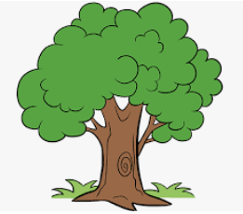
Blending – important skill
Pushing the phonemes together to make a word.
t/r/ee
Multiple syllable words – ‘chunking’
star/light
Notes:
As well as learning to recognise the graphemes and say the phonemes they represent we will be teaching children how to use these to read.
When we read a word we look at each graphemes and match a sound to it. We push the sounds together to make a word. This is called BLENDING.
Blending is a really important skills that children need lots of practice at – it will take lots of time!
Let’s have a go at blending the word: t / r / ee
We teach the children to work from left to right - identifying each grapheme and saying the phoneme. Once they have done that they go back and push the phonemes together to blend the phonemes together to read the word.
We want to teach children to recognise the grapheme quickly so they can blend it rapidly. Once they can do this their reading will become fluent – and less painful! But this really does take a hug amount of practise so it is really important that children practise this at home with the books we give them.
As children progress in their reading journey they will begin to read longer words made up of multiple syllables – starlight
We teach these words by ‘chunking’ them into syllables and blending these chunks together. But we are still identifying the GPCs and blending them together.

Slide 8
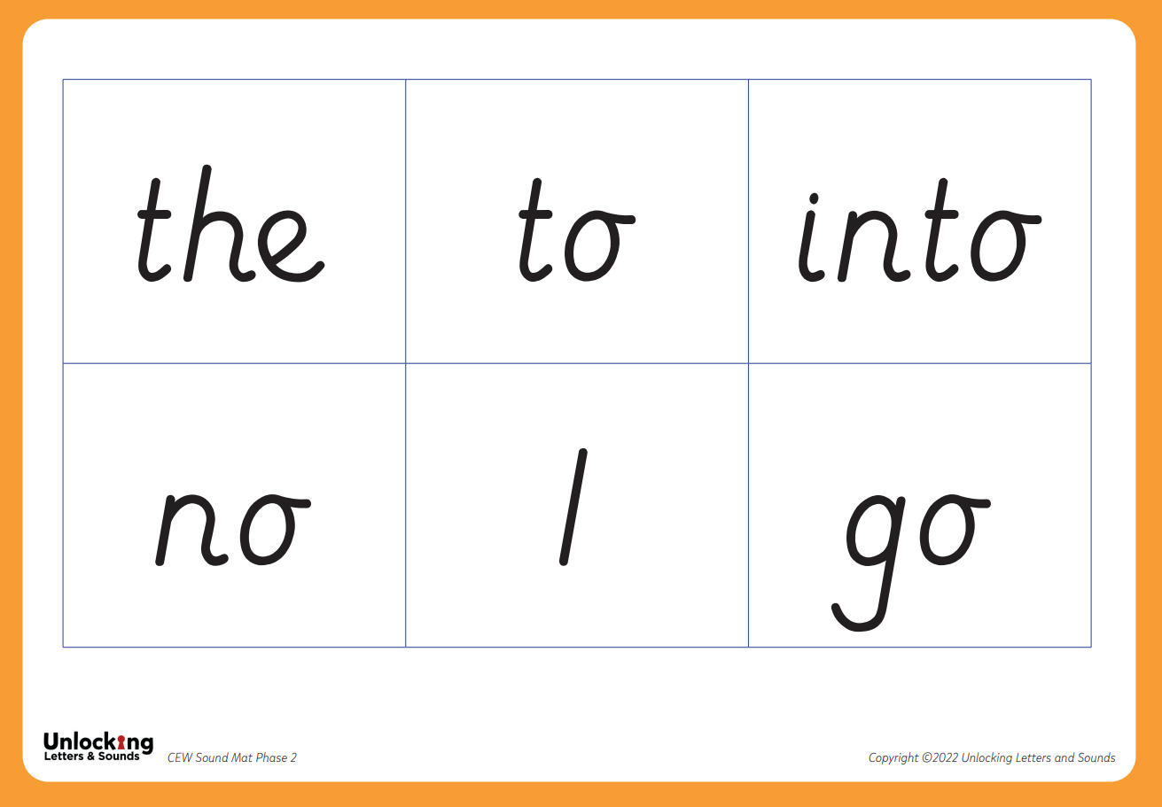
Common Exception Words
Notes:
There are some words that we use a lot in English such as the, like, said, were.
To give children’s reading a boost and so they can access more texts quickly we want children to learn these CEWs early on. Many of them have usual patterns that aren’t taught until later on. So we teach children to recognise them by sight initially. Children will be able to decode some of them later on but , until they have learnt to decode them, we recognise them as CEWs.

Slide 9

Reading and Books
https://www.youtube.com/watch?v=Hhu3xeNq3Kg&t=200s
Children will be given books when they can blend – this will be different for every child
Books precisely match children’s phonics attainment. We assess the children regularly to ensure they have the phonics knowledge and can read at least 95% of the words in their book.
When a child reads their whole book three times, it will be changed by a member of staff.
Notes:
As soon as your child can blend to read words we will be giving them their first book. This is incredibly exciting but will be different for every child. Some learn this skills very quickly and others take a bit longer – we will be supporting every child to blend as quickly as possible. Please don’t compare your child with others and contact us if you are worried about anything.
Once your child can read they will be given a book that precisely matches their phonics attainment so that they can read at least 95% of the words in it. Please don’t think that this makes the book too easy for them – it’s vitally important that reading is a celebration of children’s reading with you and a chance for them to show their phonics expertise.
In school we will also be reading with children as much as possible. They will read everyday in their phonics lessons and also every week with their teacher individually or in a guided group. The teacher will listen to every child read as well as teaching for part of the session. This allows us to check every child’s learning.
One of the most important ways to increase children’s accuracy, fluency and understanding of the book they are reading is to re-read the same books several times. This is why we only give a new book once it has been read at least three times with a different focus each time.
This films explains the value of re- reading the same book and what you should focus on each time. https://www.youtube.com/watch?v=Hhu3xeNq3Kg&t=200s

Slide 10
Reading at home
5 – 10 minutes
Choose a time that works for you
Be positive and celebrate successes
Encourage them to point to the graphemes and spot those digraphs/trigraphs in words
Encourage them to say the sounds and blend them together
Be patient and let them try and work it out
Read common exception words by sight.
Notes:
Reading at home is essential as it gives children the opportunity to practice their decoding and blending skills.
We know everyone is busy and children often don’t want to read out of schools. Our top tips are:
5 – 10 minutes every day is often more effective than longer times
Find a time that works for you. Reading at bed time sounds lovely but with a tired child it can often be tricky!
Celebrate what your child can do and
Encourage your child to point at the graphemes as they read – this helps them to track the words and know their place
Encourage them t o say all the sounds in the words and then blend them together – you can show them how to do this.
Be patient and give them time to work it out before stepping in before stepping in If they can’t read a word model how to do it and then ask them to do it.
Let them read common exception words by sight.

Slide 11
Reading at home
Encourage fluency whenever possible
Continue to read to your child
Model how to read a book – left to right, turning pages
Ask questions about what has happened and characters’ feelings
Predict what will happen next
Support vocabulary
Make connections
Model your love of reading!
Notes:
Whilst learning to decode and reading books that allow children to do this is important there is so much more to reading! We know that decodable books are not the most exciting to read and alone, won’t give our early readers all the skills they need to develop a love of reading.
It is therefore important that you continue to read to your child and share a wide range of books with them – these should be books that children cannot decode themselves. Reading books to children is a precious and lovely thing to do – we are sure you and your child already have favourite books that you share together!
When you read to your child you will want to:
Model how to read a book
Ask questions about what has happened to support your child’s comprehension or understanding of the text
Ask questions about characters’ feelings
Discuss the meaning of words and vocabulary
Ask children to predict what they think will happen next
Make connections with things your child has experienced or other books or films they have seen
Most importantly – show that you love reading! By modelling this you will support your child to develop their love of reading.

Slide 12
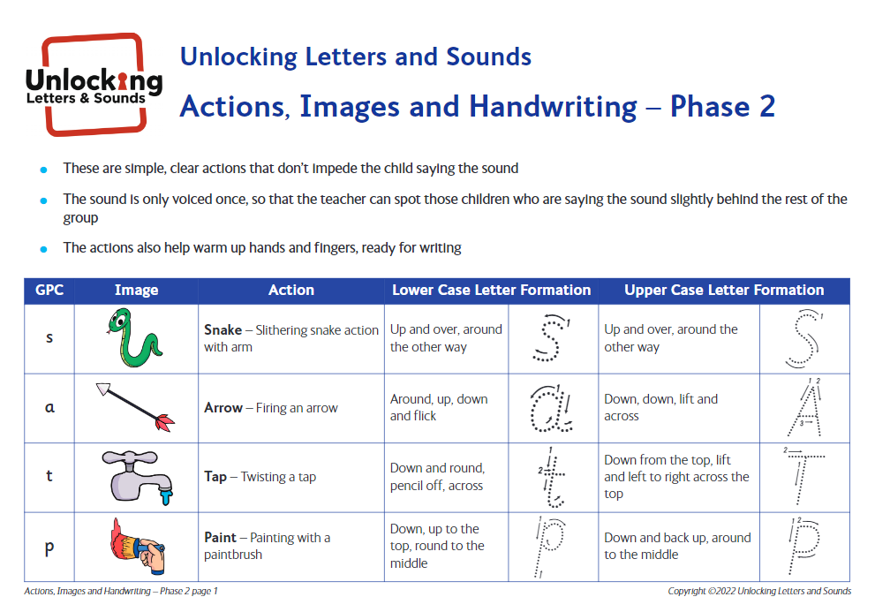

Spelling
Segmenting words
            sh-i-p
Daily writing as part of phonics lessons
Notes:
We know that when children are reading they are decoding the GPCs they know and blending them together to read a word or group of words. We teach children to use their phonics to spell in the opposite way. Instead of blending the phonemes together to spell a words we seperate the phonemes so we can hear each sound to be able to spell the word. This is called segmenting.
Let’s try segmenting this word to write it: sh i p
Your child will write words, captions and sentences as part of their phonics lesson each day. As with reading, we will only ask them to write words contacting GPCs they have been taught. As part of their daily lesson we will also teach them how to write and form the letters they are writing.

Slide 13
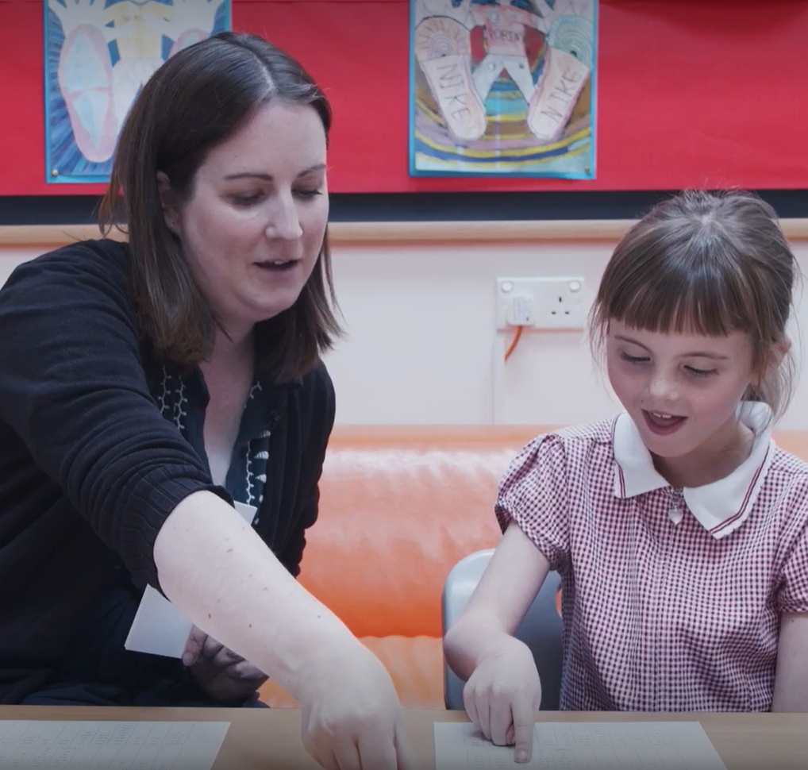
Concerns about progress
All children are different
Teachers will assess your child reguarly
Interventions to support child in the specific skill they are struggling with
Discuss any concerns with teachers
Notes:
All children are different and, at different points in their learning, will find things more difficult or challenging. Staff at our school have all had training to identify what children are finding difficult and to help them overcome this. We know if is very tempting to compare you child to others – especially with reading and what books they are on etc but we would suggest you speak to teachers if you have any concerns. If we have any concerns we will discuss them with you – and we might ask you to do some extra practice at home.
Teachers and TAs will assess your child reguarly to check their learning. We quickly identify any child who might be at risk of falling behind and will support them with extra phonics- usually by giving them ‘interventions’ to support the specific skill they are struggling with – some children may struggle to identify the GPC, others might not be able to blend yet.
If a child has SEND we ma need to make adaptions to their phonics eg. additional time to practice, more visuals . Again we will discuss these with you but research has shown that phonics is the most effective way of teaching children with SEND to read.

Slide 14
Questions and next steps
Talk to other parents who have been through this journey
YR modelled lessons
Reading buddies
Notes:
Learning to read is such an exciting journey for children and we are incredibly excited to be starting it with your child. We hope today’s session has given you an understanding of how we teach phonics at our school.
Ask for questions
Give information about next steps specific to your school eg. more workshops, coming in to read with their child etc.

